Slide 1


Price Prediction of EdTech Courses

Slide 2

Project Leadership
Sharat Manikonda
Director at Innodatatics and Sponsor
linkedin.com/in/sharat-chandra

Slide 3
Team Members
Name:
https://www.linkedin.com/profilelink
Name:
https://www.linkedin.com/profilelink
Name:
https://www.linkedin.com/profilelink
Name:
https://www.linkedin.com/profilelink
Name:
https://www.linkedin.com/profilelink
Name:
https://www.linkedin.com/profilelink

Slide 4
Team Members
Name:
https://www.linkedin.com/profilelink
Name:
https://www.linkedin.com/profilelink
Name:
https://www.linkedin.com/profilelink
Name:
https://www.linkedin.com/profilelink
Name:
https://www.linkedin.com/profilelink
Name:
https://www.linkedin.com/profilelink

Slide 5

Contents
Notes:
Change

Slide 6
Project Overview and Scope

Slide 7
Project Goals

Slide 8
CRISP-ML(Q) Methodology

Slide 9
Technical Stacks
Notes:
Pycharm add Tableau

Slide 10
Project Architecture

Slide 11
Data Collection and Understanding

Slide 12
Data Information

Slide 13
Data Dictionary

Slide 14
Data Dictionary

Slide 15
Data Dictionary
Notes:
Table change

Slide 16
Data Dictionary

Slide 17
System Requirements

Slide 19
Exploratory Data Analysis [EDA]
Notes:
EDA is used for seeing what the data can tell us before the modeling task.
Change

Slide 20
EDA Description

Slide 21
Missing Values Observation

Slide 22
Data Visualization
Notes:
Keep observations

Slide 23
Data Visualization
Notes:
Add graphical

Slide 24
Data Visualization
Notes:
Piee

Slide 25
Data Visualization
Notes:
Piee

Slide 26
Data Visualization
Notes:
Piee

Slide 27
Data Visualization
Notes:
Piee

Slide 28
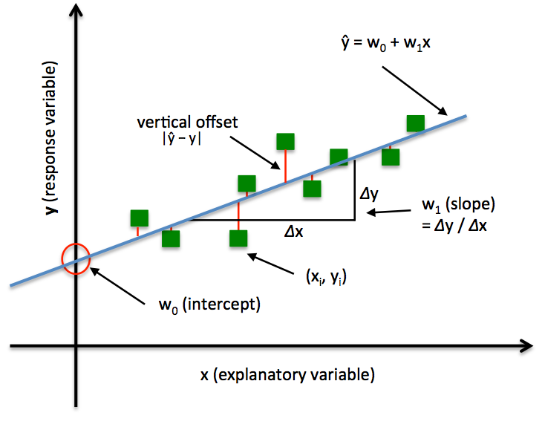
Model Building
Ordinary Least Squares regression (OLS) :
OLS is a common technique for estimating coefficients of linear regression equations which describe the relationship between one or more independent quantitative variables and a dependent variable (simple or multiple linear regression).
The simple linear regression is a model with a single regressor (independent variable) X that has a relationship with a response (dependent variable or target) Y
Y = W0 + W1 X + ε
Where
W0: intercept
W1: slope (unknown constant)
ε: random error component

Slide 29
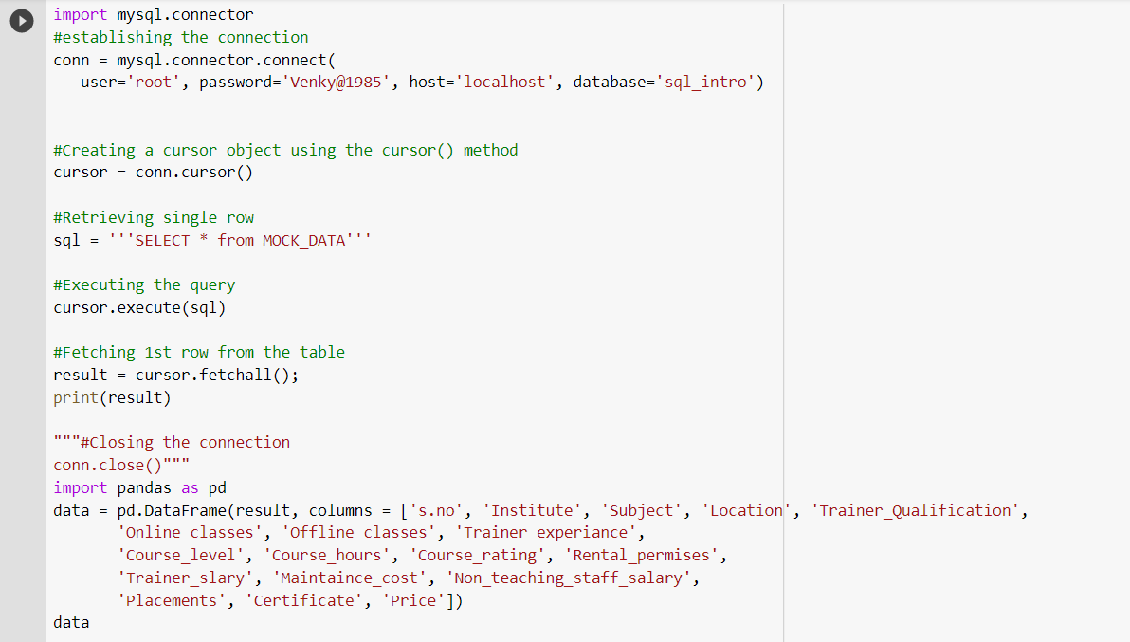
Model Building
Notes:
classification is the task of predicting a discrete class label. Regression is the task of predicting a continuous quantity.
What is classification techniques in machine learning?
The Classification algorithm is a Supervised Learning technique that is used to identify the category of new observations on the basis of training data. In Classification, a program learns from the given dataset or observations and then classifies new observation into several classes or groups.
What is regression techniques in machine learning?
Regression is a technique for investigating the relationship between independent variables or features and a dependent variable or outcome. It's used as a method for predictive modeling in machine learning, in which an algorithm is used to predict continuous outcomes.

Slide 30
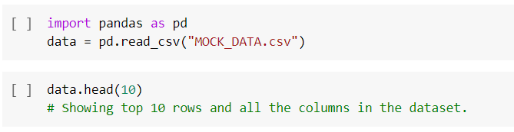



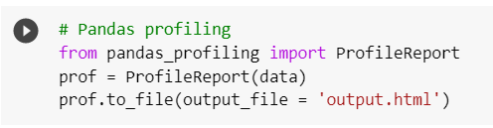
Model Building –
Notes:
What is the role of regression in ML
Is regression supervised or unsupervised?

Slide 31




Model Building

Slide 32
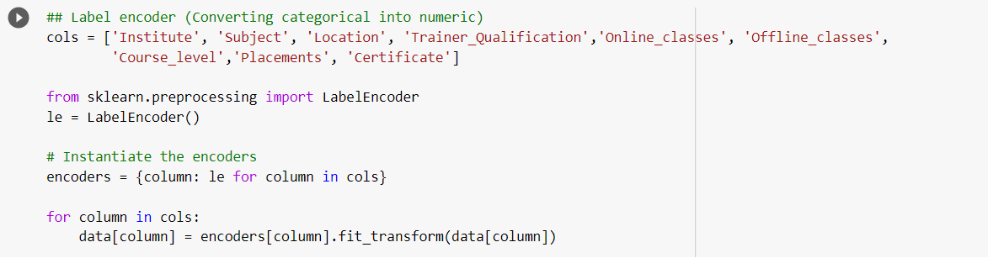
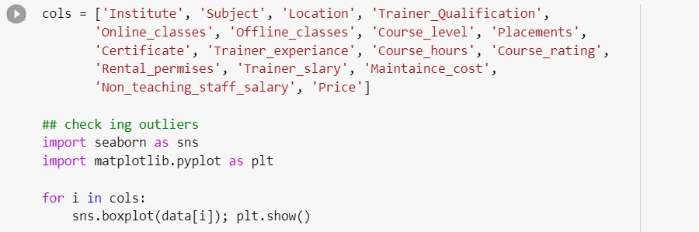
Model Building

Slide 33


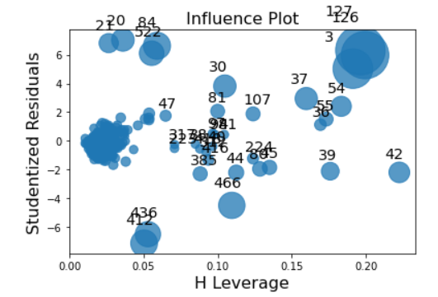
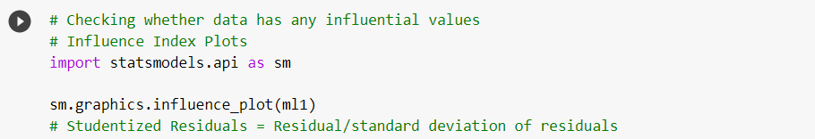
Model Building

Slide 34
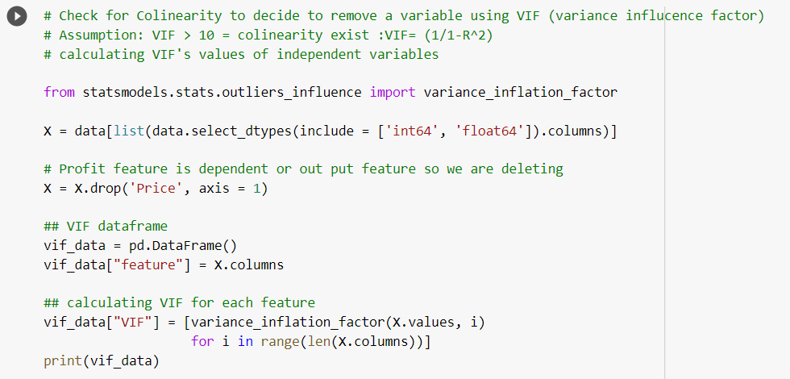
Model Building

Slide 35


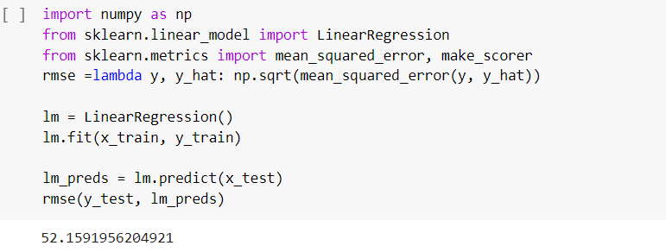
Model Building

Slide 36

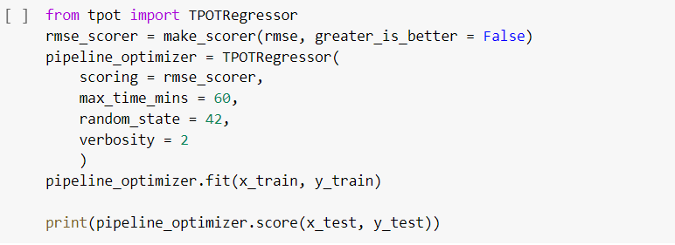

Model Building (Auto ML)

Slide 37
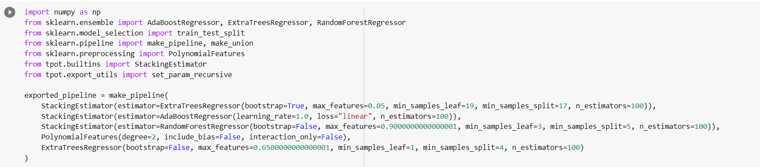
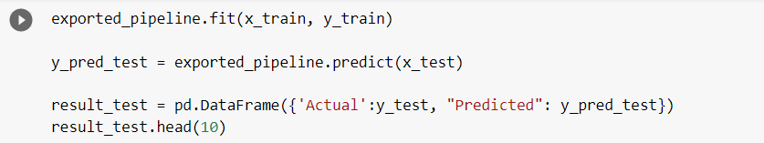
Model Building

Slide 38
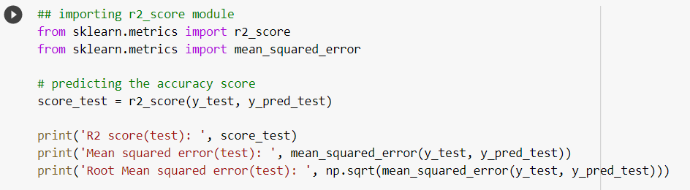
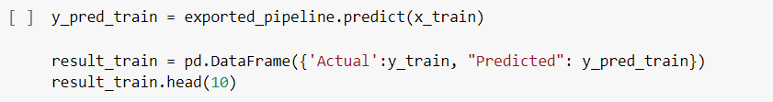
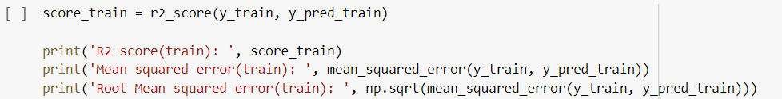
Model Building

Slide 39
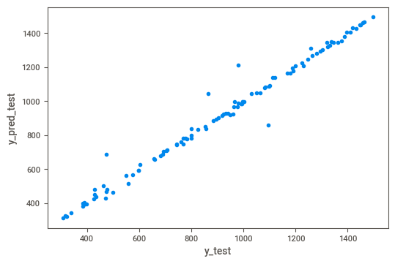
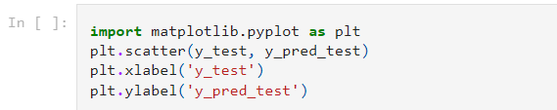



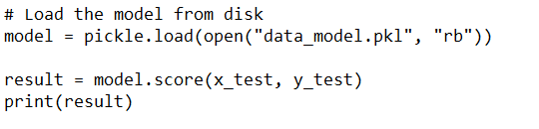
Model Building

Slide 40
Model Building
S.No | Model | Test Accuracy (R2) | Train Accuracy (R2) | Root Mean Squared Error (RMSE)_Test | Root Mean Squared Error (RMSE)_Train
1 | Multi Linear Regression(MLR) | 97.587 | 99.161 | 52.159 | 31.628
2 | TPOT Regressor (ExtraTreesRegressor) | 98.202 | 99.988 | 45.025 | 1.424
3

Slide 41
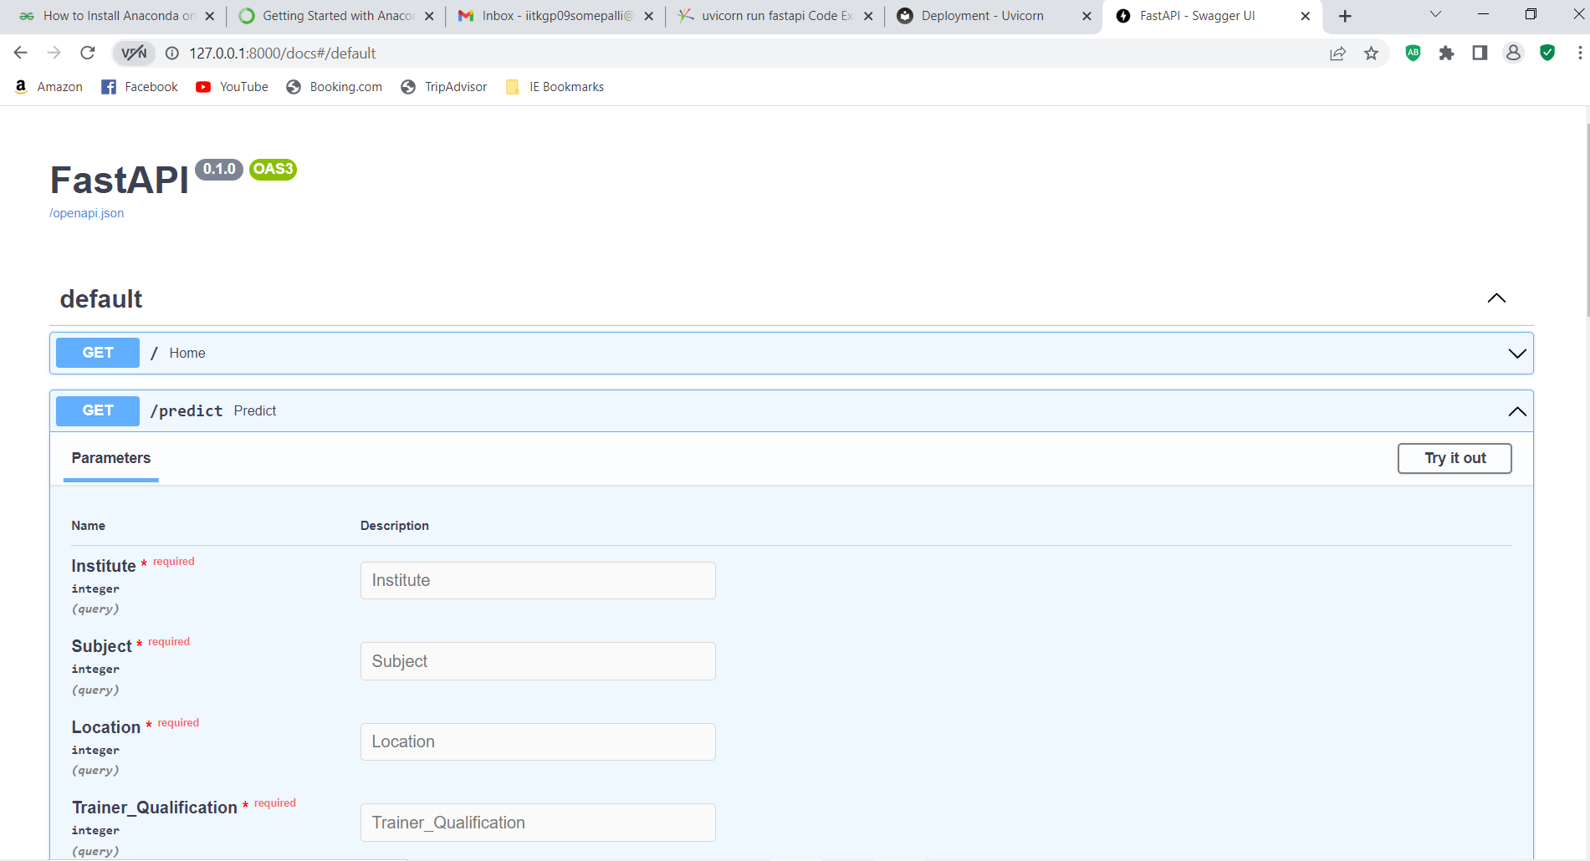

Slide 42
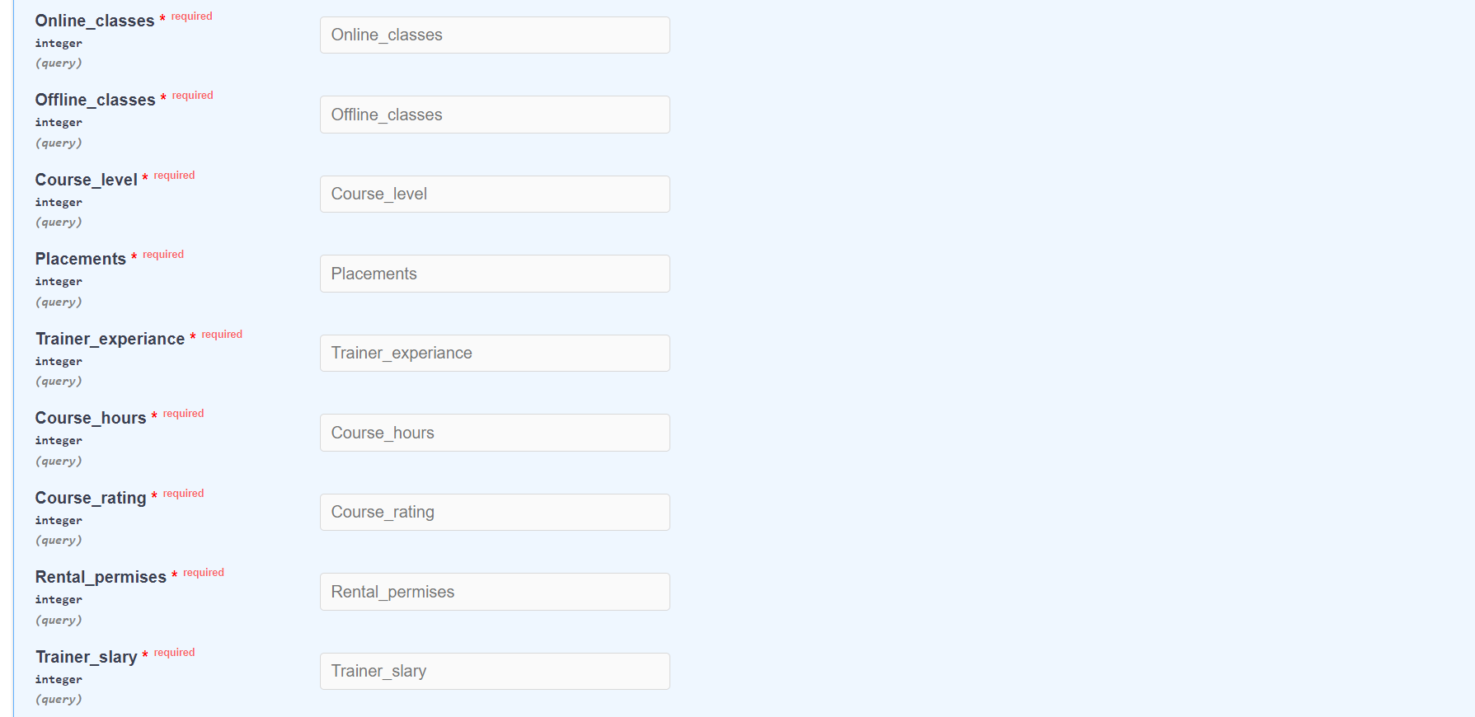

Slide 43
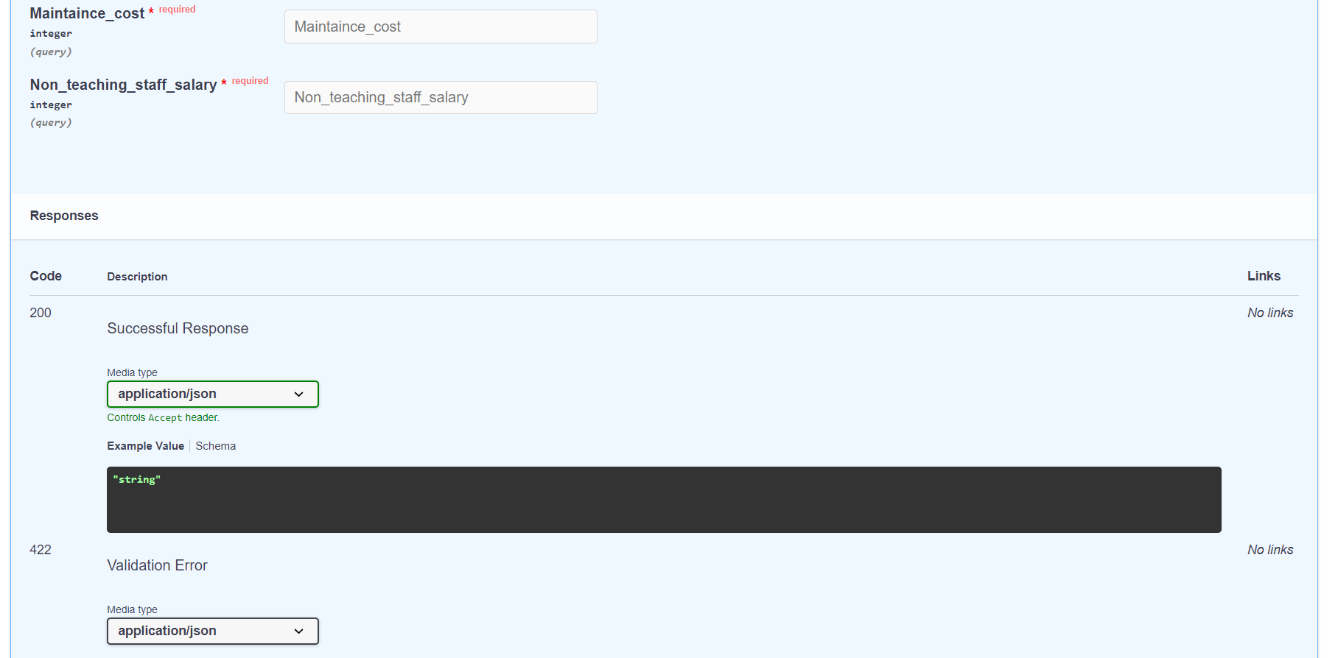

Slide 44
Model Deployment - Strategy

Slide 45
Screen shot of output

Slide 46
Screen shot of output

Slide 47
Screen shot of output

Slide 48
Video of output

Slide 49
Challenges

Slide 50
Future Scopes

Slide 51

Queries ?

Slide 52


